Slide 1
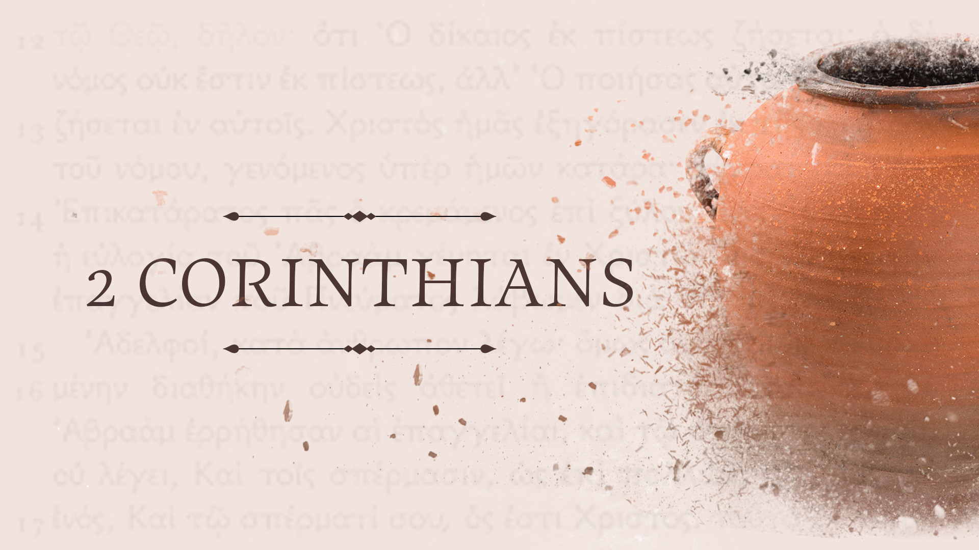

Slide 2


Slide 4

2 Corinthians 3:7-18
Why should believers today walk around with more BOLDNESS THAN MOSES?

Slide 5
2 Corinthians 3:7-18
Why should believers today walk around with more BOLDNESS THAN MOSES?
Because we possess something MORE GLORIOUS (v.7-11)

Slide 6
2Corinthians 3:7-11 (esv)
⁷ Now if the ministry of death, carved in letters on stone, came with such glory that the Israelites could not gaze at Moses’ face because of its glory, which was being brought to an end, ⁸ will not the ministry of the Spirit have even more glory? ⁹ For if there was glory in the ministry of condemnation, the ministry of righteousness must far exceed it in glory. ¹⁰ Indeed, in this case, what once had glory has come to have no glory at all, because of the glory that surpasses it. ¹¹ For if what was being brought to an end came with glory, much more will what is permanent have glory.

Slide 8
2 Corinthians 3:7-18
Why should believers today walk around with more BOLDNESS THAN MOSES?
Because we possess something MORE GLORIOUS (v.7-11)

Slide 9
2 Corinthians 3:7-18
Why should believers today walk around with more BOLDNESS THAN MOSES?
Because we possess something MORE GLORIOUS (v.7-11)
Because we know the VEIL CAN BE LIFTED (v.12-18)

Slide 10
2Corinthians 3:12-18 (esv)
¹² Since we have such a hope, we are very bold, ¹³ not like Moses, who would put a veil over his face so that the Israelites might not gaze at the outcome of what was being brought to an end. ¹⁴ But their minds were hardened. For to this day, when they read the old covenant, that same veil remains unlifted, because only through Christ is it taken away. ¹⁵ Yes, to this day whenever Moses is read a veil lies over their hearts. ¹⁶ But when one turns to the Lord, the veil is removed. ¹⁷ Now the Lord is the Spirit, and where the Spirit of the Lord is, there is freedom. ¹⁸ And we all, with unveiled face, beholding the glory of the Lord, are being transformed into the same image from one degree of glory to another. For this comes from the Lord who is the Spirit.

Slide 12
Big Idea
If the object of your faith has GREATER SPLENDER,
it should bring about GREATER BOLDNESS!

