Slide 1


Slide 2
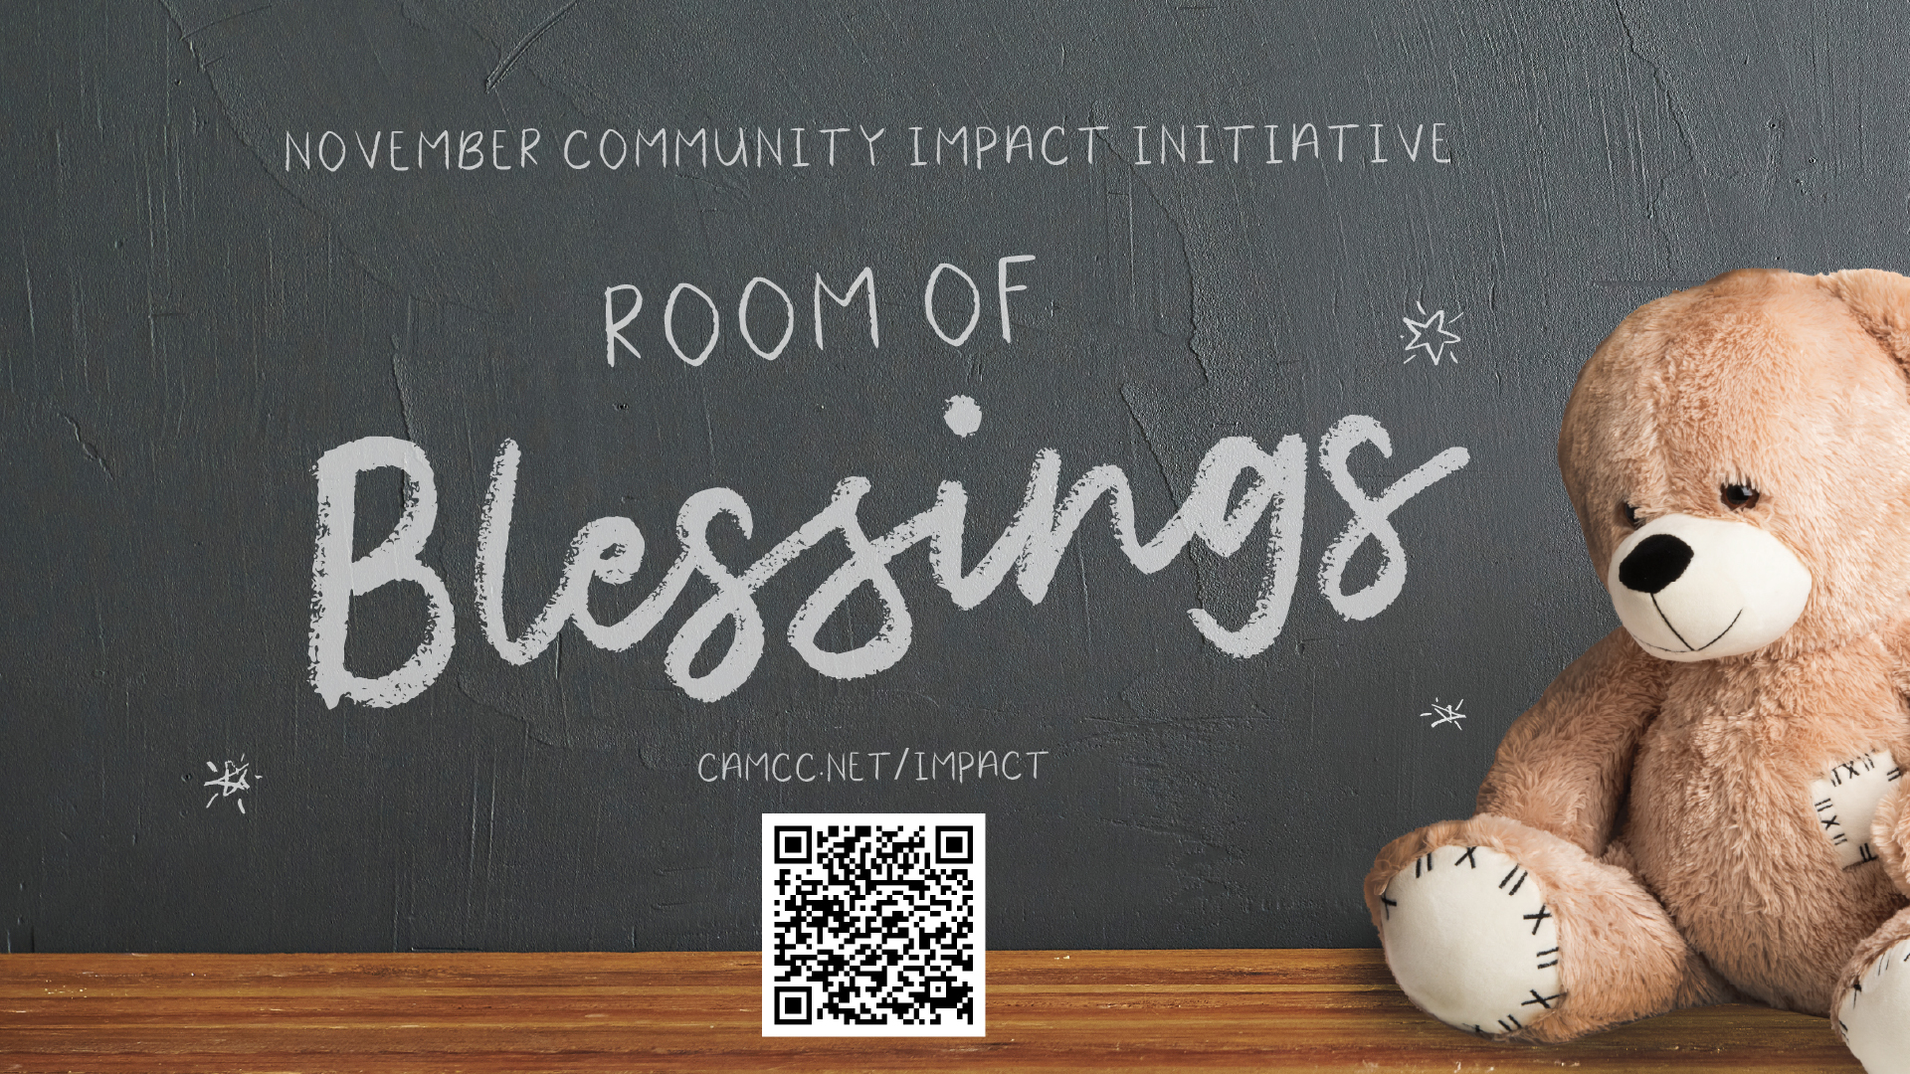

Slide 4


Slide 6

2 Samuel 15:1-12
What happens when we don’t deal with our feelings of RESENTMENT?

Slide 7
2 Samuel 15:1-12
What happens when we don’t deal with our feelings of RESENTMENT?
We can develop a CONNIVING PERSONALITY (v.1-6)

Slide 8
2 Samuel 15:1-4 (esv)
After this Absalom got himself a chariot and horses, and fifty men to run before him. ² And Absalom used to rise early and stand beside the way of the gate. And when any man had a dispute to come before the king for judgment, Absalom would call to him and say, “From what city are you?” And when he said, “Your servant is of such and such a tribe in Israel,” ³ Absalom would say to him, “See, your claims are good and right, but there is no man designated by the king to hear you.” ⁴ Then Absalom would say, “Oh that I were judge in the land! Then every man with a dispute or cause might come to me, and I would give him justice.”

Slide 9
2 Samuel 15:5-6 (esv)
⁵ And whenever a man came near to pay homage to him, he would put out his hand and take hold of him and kiss him. ⁶ Thus Absalom did to all of Israel who came to the king for judgment. So Absalom stole the hearts of the men of Israel.

Slide 11
2 Samuel 15:1-12
What happens when we don’t deal with our feelings of RESENTMENT?
We can develop a CONNIVING PERSONALITY (v.1-6)

Slide 12
2 Samuel 15:1-12
What happens when we don’t deal with our feelings of RESENTMENT?
We can develop a CONNIVING PERSONALITY (v.1-6)
We can develop a SUPERIORITY COMPLEX (v.7-12)

Slide 13
2 Samuel 15:7-10 (esv)
⁷ And at the end of four years Absalom said to the king, “Please let me go and pay my vow, which I have vowed to the Lord, in Hebron. ⁸ For your servant vowed a vow while I lived at Geshur in Aram, saying, ‘If the Lord will indeed bring me back to Jerusalem, then I will offer worship to the Lord.’ ” ⁹ The king said to him, “Go in peace.” So he arose and went to Hebron. ¹⁰ But Absalom sent secret messengers throughout all the tribes of Israel, saying, “As soon as you hear the sound of the trumpet, then say, ‘Absalom is king at Hebron!’ ”

Slide 14
2 Samuel 15:11-12 (esv)
¹¹ With Absalom went two hundred men from Jerusalem who were invited guests, and they went in their innocence and knew nothing. ¹² And while Absalom was offering the sacrifices, he sent for Ahithophel the Gilonite, David’s counselor, from his city Giloh. And the conspiracy grew strong, and the people with Absalom kept increasing.

Slide 16
Big Idea
Resentment TRANSFORMS you into the
person that you should DESPISE!

