Slide 1
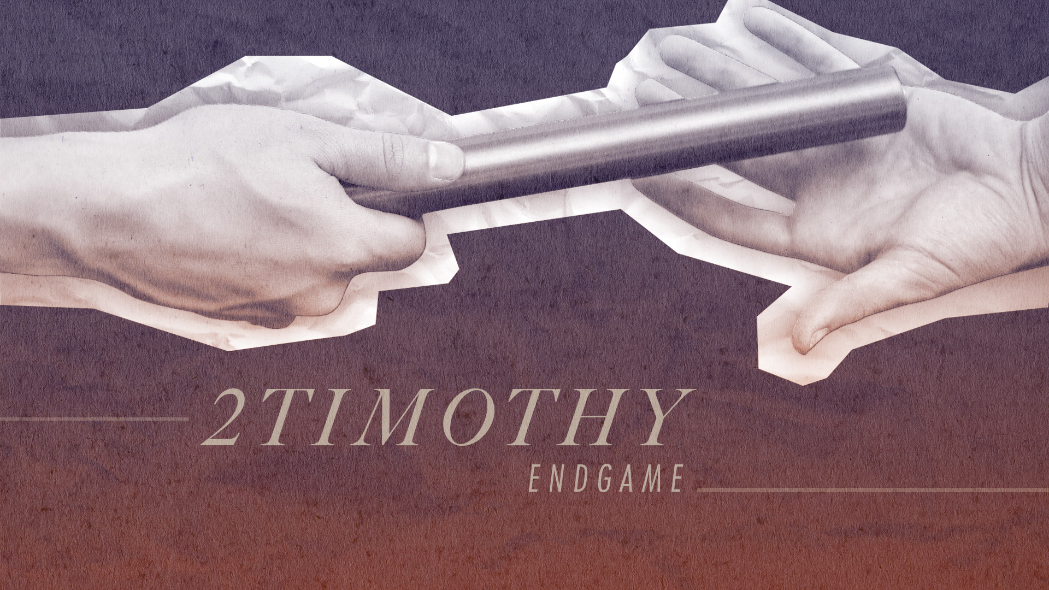

Slide 2


Slide 3

2 Timothy 2:8-13
Why should I obey the biblical mandates of JOYFUL and FAITHFUL SUFFERING?

Slide 4
2 Timothy 2:8-13
Why should I obey the biblical mandates of JOYFUL and FAITHFUL SUFFERING?
Because a VICTOROUS Savior and Gospel are worth being glad about (v.8-10)

Slide 5
2 Timothy 2:8-10 (esv)
8 Remember Jesus Christ, risen from the dead, the offspring of David, as preached in my gospel, 9 for which I am suffering, bound with chains as a criminal. But the word of God is not bound! 10 Therefore I endure everything for the sake of the elect, that they also may obtain the salvation that is in Christ Jesus with eternal glory.

Slide 6
2 Timothy 2:8-13
Why should I obey the biblical mandates of JOYFUL and FAITHFUL SUFFERING?
Because a VICTOROUS Savior and Gospel are worth being glad about (v.8-10)

Slide 7
2 Timothy 2:8-13
Why should I obey the biblical mandates of JOYFUL and FAITHFUL SUFFERING?
Because a VICTOROUS Savior and Gospel are worth being glad about (v.8-10)
Because God is FAITHFUL to bring you to your ETERNAL reward (v.11-13)

Slide 8
2 Timothy 2:11-13 (esv)
11 The saying is trustworthy, for: If we have died with him, we will also live with him; 12 if we endure, we will also reign with him; if we deny him, he also will deny us; 13 if we are faithless, he remains faithful— for he cannot deny himself.

Slide 9
Big Idea
The gospel gives us both
the POWER to endure and the REASON to endure.

